Slide 1
Ridge and Lasso Regression
Noble Xavier

Slide 2
Ridge and Lasso Regression
Ridge and Lasso regression are some of the simple techniques to reduce model complexity and prevent over-fitting which may result from simple linear regression.
Ridge Regression: In ridge regression, the cost function is altered by adding a penalty equivalent to the square of the magnitude of the coefficients.
Lasso Regression: Lasso shrinks the less important feature’s coefficient to zero thus, removing some features altogether. So, this works well for feature selection in case we have a huge number of features.

Slide 3
Ridge and Lasso Regression
A regression model that uses L1 regularization technique is called Lasso Regression and the model which uses L2 is called Ridge Regression.
L2 regularization takes the square of the weights, so the cost of outliers present in the data increases exponentially.
L1 regularization takes the absolute values of the weights, so the cost only increases linearly

Slide 4
Ridge and Lasso Regression
The key difference is in how they assign penalties to the coefficients:
Ridge Regression:
  Performs L2 regularization, i.e., adds penalty equivalent to the square of the magnitude of coefficients
  Minimization objective = LS Obj + α * (sum of square of coefficients)
Lasso Regression:
  Performs L1 regularization, i.e., adds penalty equivalent to the absolute value of the magnitude of coefficients
  Minimization objective = LS Obj + α * (sum of the absolute value of coefficients)
Here, LS Obj refers to the ‘least squares objective,’ i.e., the linear regression objective without regularization.

Slide 5
Difference Between Lasso/L1Regularization and Ridge /L2 Regularization
L1 Regularization | L2 Regularization
The penalty term is based on the absolute values of the model's parameters. | The penalty term is based on the squares of the model's parameters.
Produces sparse solutions (some parameters are shrunk towards zero). | Produces non-sparse solutions (all parameters are used by the model).
Sensitive to outliers. | Robust to outliers.
Selects a subset of the most important features. | All features are used by the model.
Optimization is non-convex. | Optimization is convex.
The penalty term is less sensitive to correlated features. | The penalty term is more sensitive to correlated features.
Useful when dealing with high-dimensional data with many correlated features. | Useful when dealing with high-dimensional data with many correlated features and when the goal is to have a less complex model.
Also known as Lasso regularization. | Also known as Ridge regularization.

Slide 6
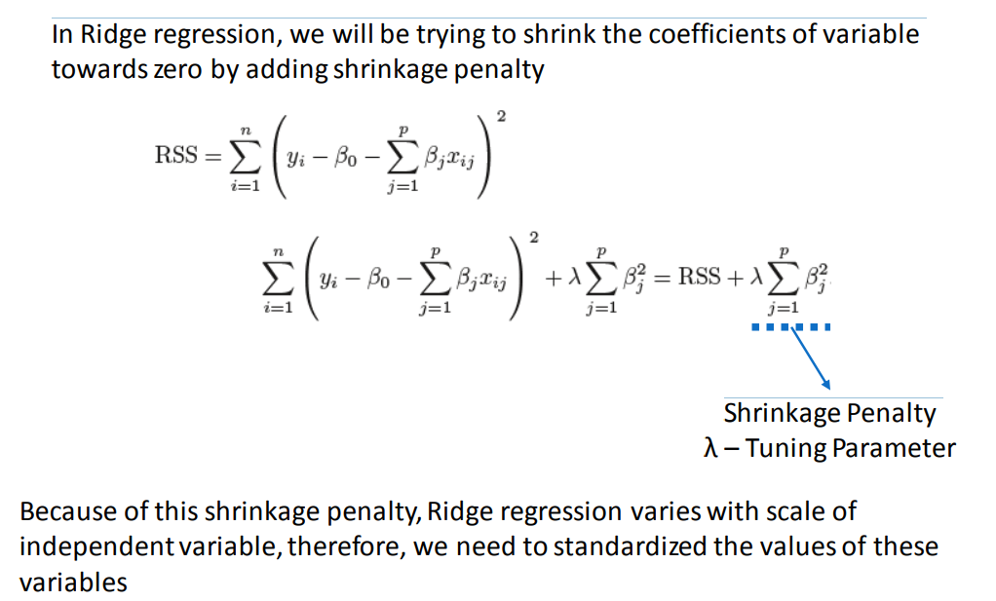
Ridge Regression
(RSS - Residual sum of squares)

Slide 7
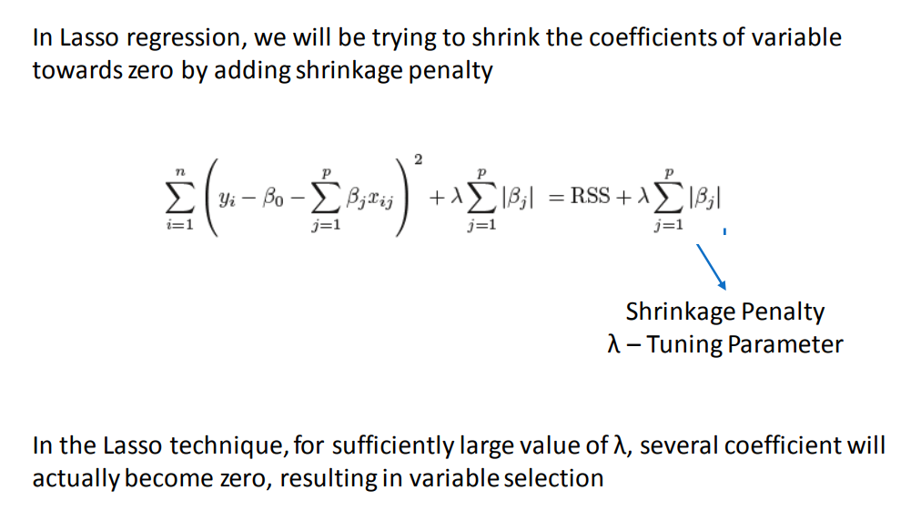
Lasso Regression

Slide 8
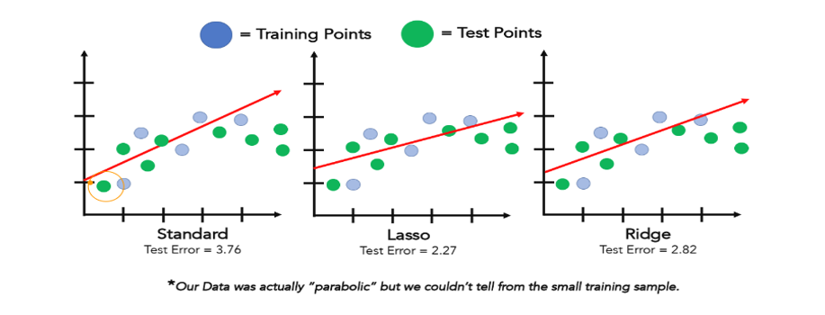
Ridge and Lasso Regression

Slide 9
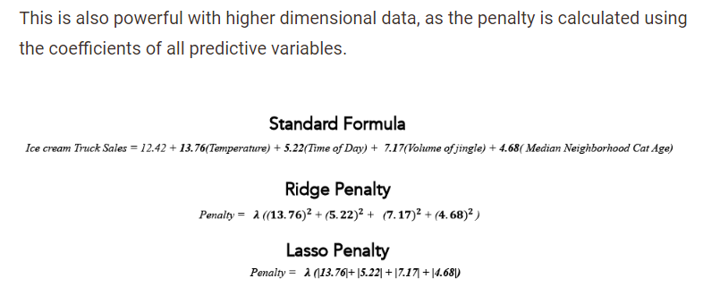
Ridge and Lasso Regression

Slide 10
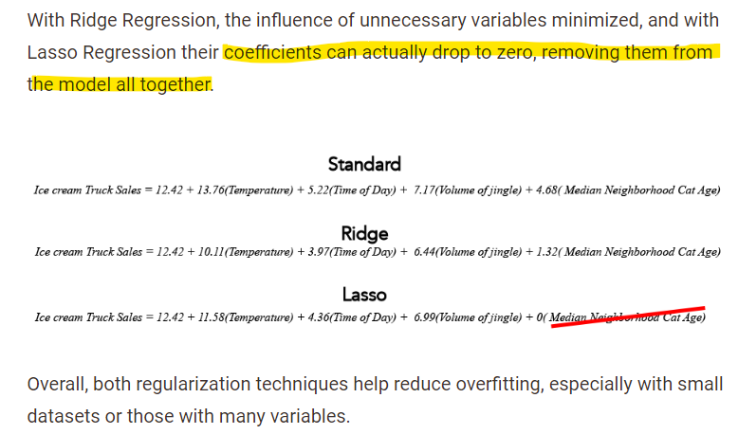
Ridge and Lasso Regression

